Slide 1
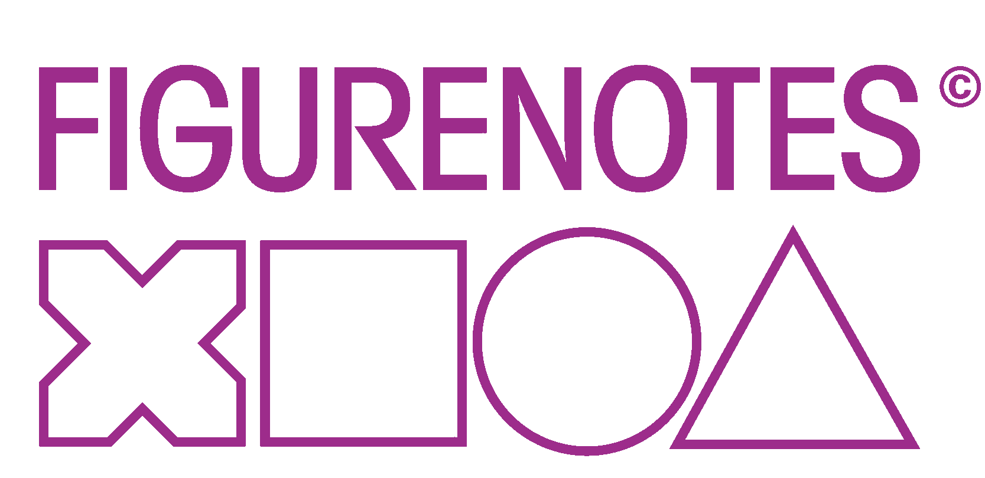

Slide 2
What is Figurenotes?
An alternative notation system using colour and shape
to show pitch and rhythm
Each octave is a different shape
Each note is a different colour
Middle C
Notes:
Invented in Finland by Markku Kaikkonen and Kaarlo Uusitalo from Resonaari – Used with adults with learning disabilities
Note = Colour Red, Brown, Grey, Blue, Black, Yellow, Green and back to red again.
Octave = Shape Middle C is a circle, the octave below is a square, below that is a cross. The octave above middle C is a triangle.

Slide 3
Two ways to use Figurenotes
Match a note on page to sticker on the instrument
Teach fingering as you would normally for woodwind and brass

Slide 4
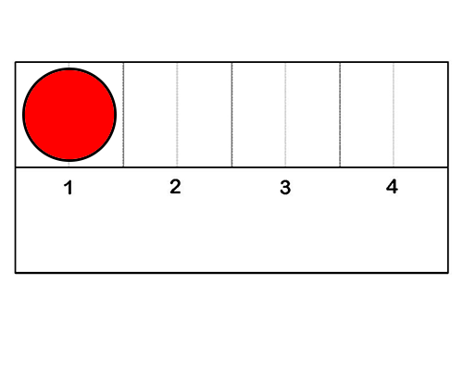
Matching
“Find and play”
“Play in pulse”
Notes:
The basic principle in using Figurenotes is ‘Matching’. So the musician can find a middle C by simply locating the red circle.

Slide 5
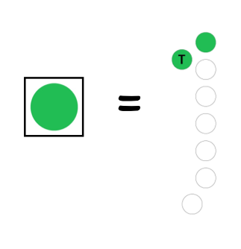
Woodwind and Brass Fingering
Teach your pupils a fingering with a colour rather than a note name

Slide 6
Bars
Every bar in Figurenotes is the same length
This literal system helps the learner to keep in time without confusion over different bar lengths like in standard notation
Notes:
Bars are always the same length. We can change the length, but it is the same for the whole piece.
Same size – always!

Slide 7
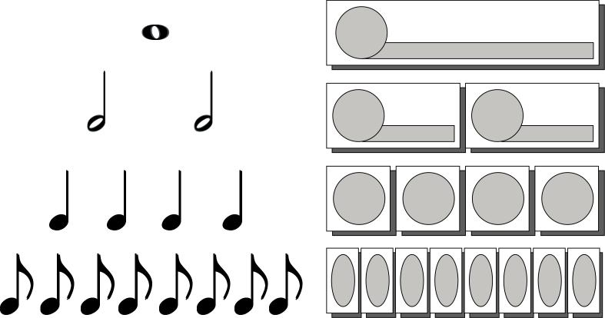
Note values
The note is as long as it looks
Why do we add something to a note to make it shorter?
Notes:
Very literal
Start note on shape – hold on tail
Describe the notes for the blind

Slide 8
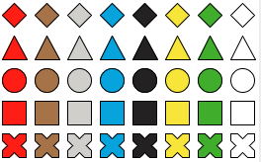
The rests
Rests are shown by empty boxes:
You can also use white notes instead, which some learners find easier
Notes:
Much less abstract

Slide 9
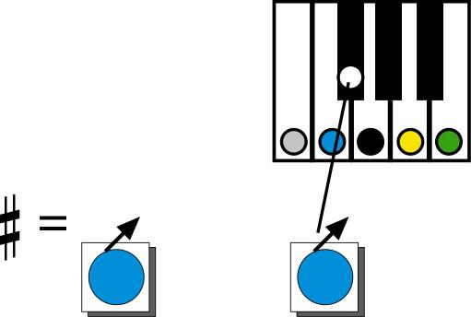
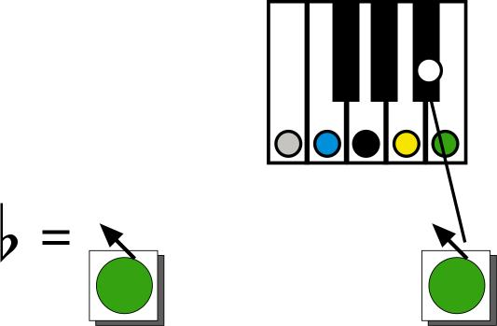
Sharps and flats
Sharps and flats are indicated by an arrow
An arrow to the right is a sharp
An arrow to the left is a flat
Notes:
Right = Sharp
Left = Flat

Slide 10
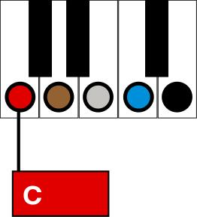
How to play chords
Step 1 “Play a colour”
Root note (1st)

Slide 11
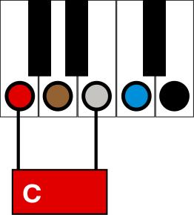
Step 2 “Play a colour and a friend”
(A friend is not a neighbour)
Root note (1st) and 3rd

Slide 12
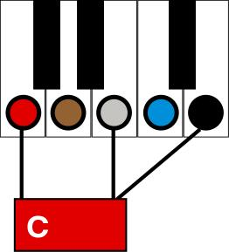
Step 3 “Play a colour with two friends”
Root note (1st), 3rd and 5th - TRIAD

Slide 13
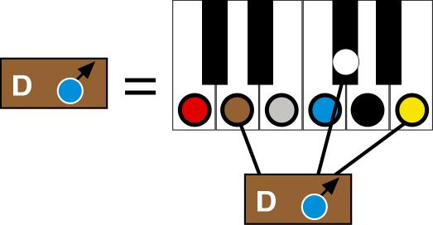
Chords with “black keys”
The black key shape will be shown
in the chord box

Slide 14
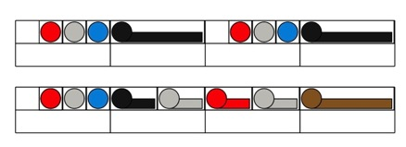
Progression
Stage 1
All on one line
Stage 2
Figurenotes on the stave
Stage 3
Coloured notes
Notes:
Describe Figurenotes on the stave
More than one stage in one class. Work at own level, but together, playing the same thing, reading it differently.

Slide 15
Stage 1
Notes
Note lengths
Play straight away
No clef
No time signature
Teach on a need to know basis

Slide 16
Stage 2
Pitch
Notes
Note lengths
See relationship of notes in different octaves on the stave
Play straight away
No clef
No time signature
Teach on a need to know basis

Slide 17
Stage 3
Standard notation symbols
Pitch
Notes
Note lengths
See relationship of notes in different octaves
Play straight away
All information present now
Still don’t need to teach what clefs are or time signatures

Slide 18
Everyone Can Play Music
Instant Success
Confidence
Motivation
Progression

Slide 19
Who can it help?
Autism Spectrum
Dyslexia
Learning Difficulties
Early Years
Anyone who has every struggled with notation
How does it help?
Anyone that can match can use it
Takes away first barriers
Less Abstract and more literal

Slide 20
Applications
Instrumental 1:1 lessons
Groups with varying ability – use different stages at the same time
Band Sessions – You can have everyone playing in 5 minutes
Composition and Creative Play with colour
Notes:
Takes away barrier, instant success, can get through pieces quicker and eventually go onto conventional notation without having been held back by it.
Doesn’t single people out if all start on FN. Different stages can play together. Inclusive.
Makes Bands sessions easy – shout RED and everyone changes to that chord or note etc. Can play songs they know very easily (may need to change the key) which gives confidence and enthusiasm.
Instant success is extremely motivating. Not dealing with abstract symbols that make no sense. Easy to get it right first time, but still learning about rhythm etc.

Slide 21
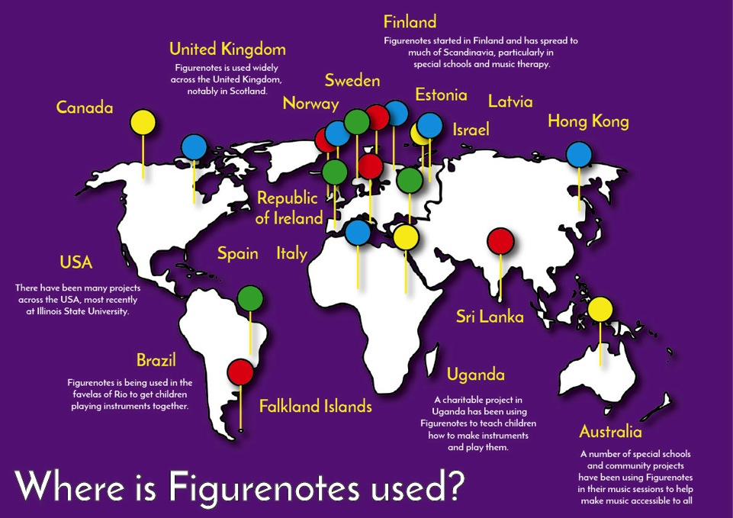

Slide 22
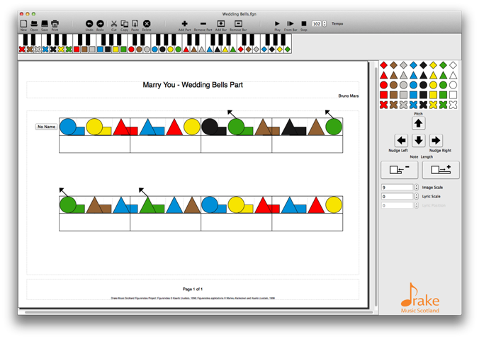
Figurenotes Software
Melody, chords, percussion, lyrics
Write your own worksheets
Use with pupils for composition
Simple and easy to use

Slide 23
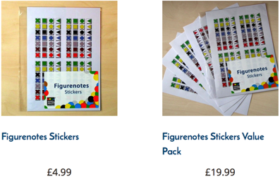
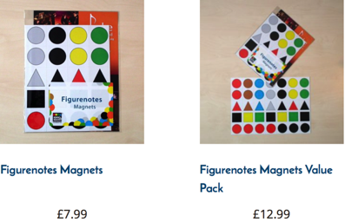
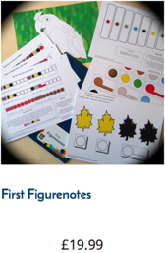
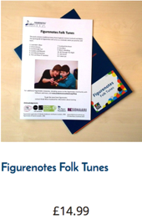
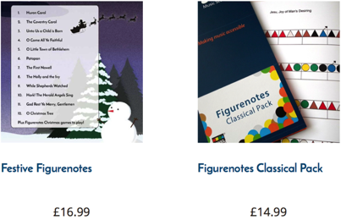
www.figurenotes.org/shop

Slide 24
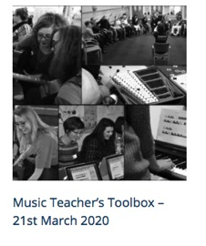
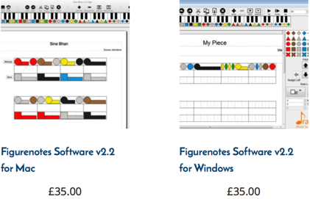
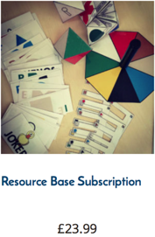
www.figurenotes.org/shop

Slide 25
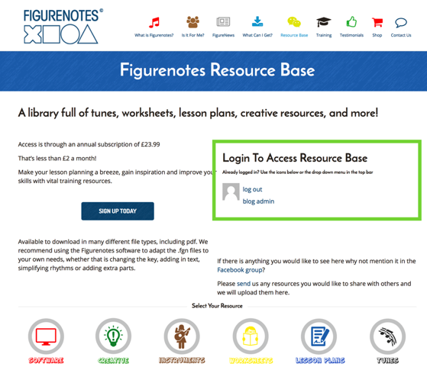
Resource Base
A library of:
Worksheets
Lesson plans
Tunes
Schemes of work
Creative resources
Tutorials
and much more!
Download as much as you like
£23.99 per year
(that’s less than £2 per month!)

Slide 26
Next Steps…
Training
Music Teacher’s Toolbox
Bespoke Training for groups (please ask for more information)
Social Media
YouTube – Figurenotes
Facebook – /Figurenotes and ‘Figurenotes – Let’s Make Music’
Twitter - @Figurenotes
Mailing List – Sign up on the website
www.figurenotes.org

