Slide 1

Figurenotes Software
Lauren Clay

Slide 2
Creating a Composition
Target
    Create a tune with more than one part
    Create a worksheet

Slide 3

Getting Started
Launch SimpleSynth if using a MAC
Garageband will also work
Open Figurenotes

Slide 4
Time Signature
Go to Edit – Set Time Sig
Shortcut = cmd + G
Always in crotchets, just change the number of beats in a bar.

Slide 5
Setting Up Your Piece
Double click the title area
Alternatives = cmd+T or Edit Menu – Page Setup
Enter details for a new piece
‘Advanced’ button
Have a play around with the margins. You might want to do this after you have finished your piece.

Slide 6
Edit Part Information
Click the ‘Piano’ button at the start of the part
You can type a name or delete it
Melody/Chord/Percussion
Check ‘Show Lyrics in Part’ box
You can choose your sound
Move parts up and down
Select clef

Slide 7
Adding Notes
Drag and Drop
Keyboard and/or Palette
Double Click
Preferences – Hide Keyboard
3 ways to change note value:
Select note and use extending button on right
Shortcuts: 1, 2, 3, 4 -Denotes how many beats. E = Quaver
Shift + L/R arrows

Slide 8
Changing Pitch
Two ways:
Select note and use arrows on right hand side ‘Pitch’
Shift + up/down arrows
To change multiple notes:
Select the first note
Shift + select last note
Change as normal.

Slide 9
Copy and Paste
Click the first note of the passage
Shift + Click the last note of the passage
Cmd+C or Ctrl+C or Edit/Copy
Select where you want to paste
Cmd+V or Ctrl+V or Edit/Paste

Slide 10
Adding Parts
Click the ‘Add Part’ button in the tool bar.
Try creating a chord part and a percussion part.
Change this by clicking on the part names to open the Edit Part Information box.

Slide 11
Lyrics
Select the note where you want to add the first lyric
Cmd + L or Ctrl + L
Start typing
Space bar or hyphen will move to the next note
Lyrics are limited to the length of the note. Change the image scale and lyric scale to accommodate longer words.

Slide 12
Saving
Save As will save as a Figurenotes file (.fgn)
You can now print straight from the programme.
You can also save as MIDI or PDF
If you cannot save, make sure you have registered your software using the code you received when you bought your subscription.

Slide 13
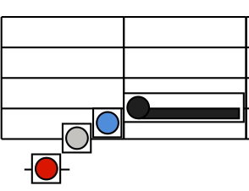
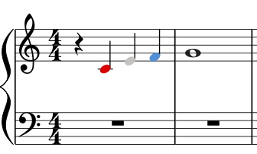
Progression
There are two views available within your software
Go to View – Display Format – Figurenotes on Staff
MuseScore and Sibelius plugins are available for coloured noteheads (Stage 3)
Sibelius – check your chords
MuseScore – check your enharmonics

Slide 14
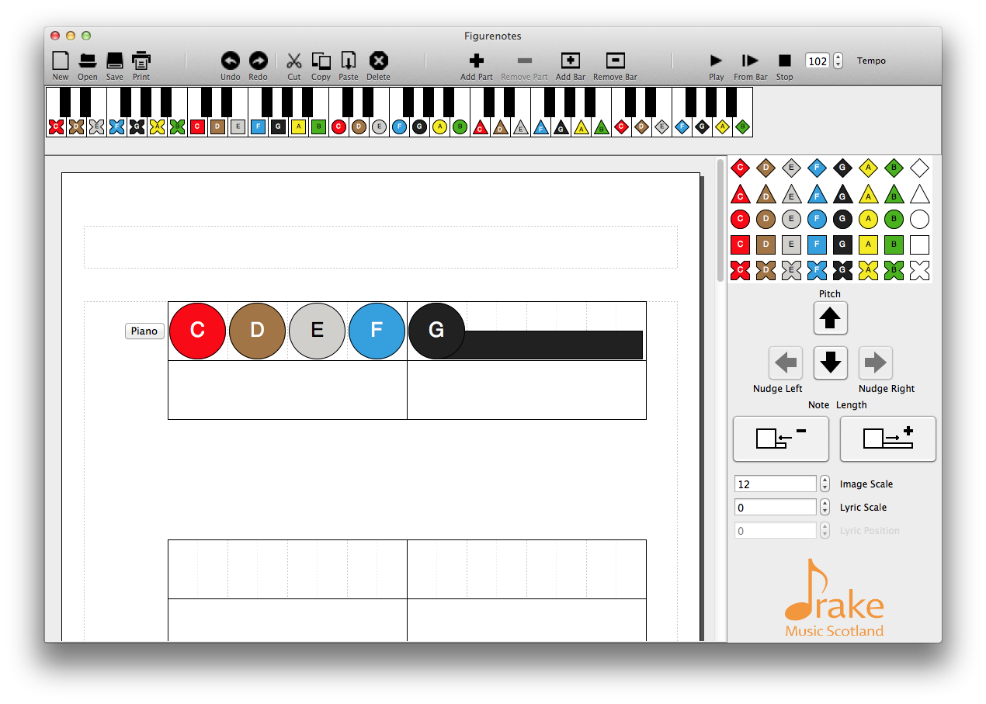
Note names
Go to View – Note Names
Letters – Puts note names in the centre of the note
Letters-H – Uses the ‘German’ system
Solfege – Puts Do, Re, Mi, etc. in the centre of the note

Slide 15
XML and MDI
You can open .xml files in Figurenotes
Please note that this needs to be a single line, as everything will end up in one part in Figurenotes
You can Save As MIDI in Figurenotes and open this in other software, such as Sibelius and MuseScore
Plugins are available on our software page

Slide 16
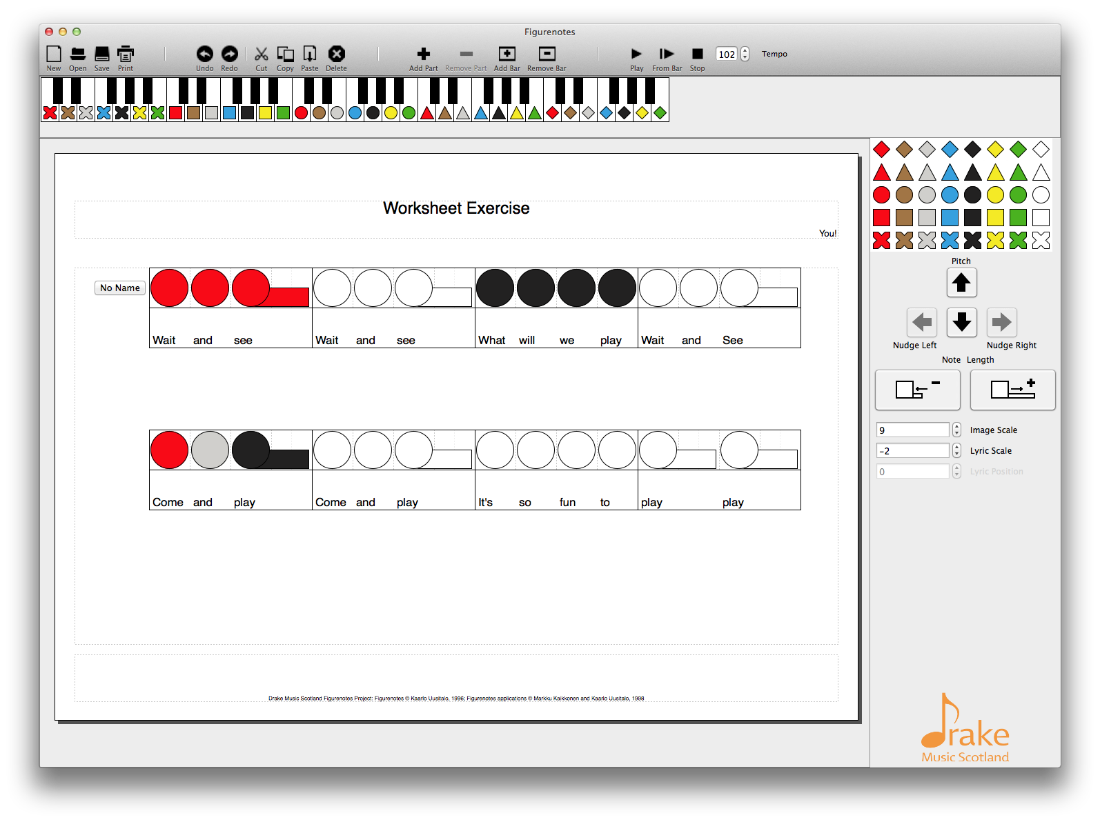
Create a Worksheet
Open a new sheet
Change time signature if required
Double click the title area
Make Landscape and put in title
Click to make Image Size bigger
Use both coloured and white icons to create a worksheet
Use lyrics too (cmd+L)
Save as pdf

